Slide 1
Predictive Maintenance over Cloud
TEG Tech Events FY19 Hackathon
16 February 2019
Notes:
Guidelines: Although the basic template is expected to be kept like so, teams expected to be creative at wherever possible while preparing this presentation pitch.
Team Name: Add team name to the entry field
Hackathon Date: Add date to the entry field

Slide 2
Technocrats
Mentor | : | Deepu L R
Ideator | : | Mubarak A R
Team Lead | : | Swapna K V
Team Members | : | Preetha Joy, Jackson P Vincent, Jogi Joseph George
Notes:
Idea/Solution/Prototype: Give a one-liner about the solution for the given problem statement
Team Name: Add team name to the entry field
Mentor Name: Add mentor’s name to the entry field
Ideator Name: Add ideator’s name to the entry field
Team Lead Name: Add team lead’s name to the entry field
Team Members Name: Add team member’s name to the entry fields one after another

Slide 3
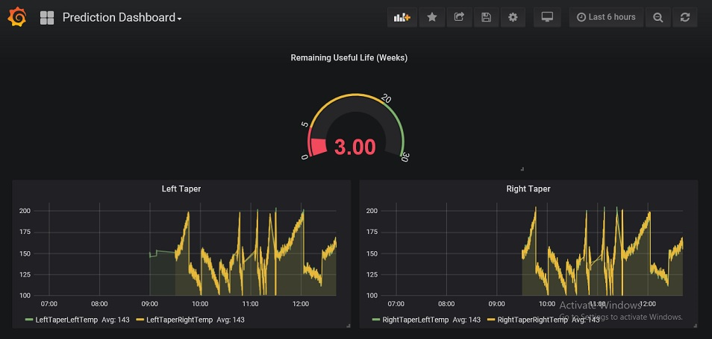
Scope
Problem Statement
Approach
Outcome
Predictive Maintenance of Equipment over cloud
Analyze and learn the trend based on the historical data from hardware over a period, and come up with Machine Learning based solution for the prediction.
Analyze the data from the hardware and predict the maintenance time upfront.
Notes:
Problem Statement: Illustrate the basic problem along with technologies used
Approach: Methods planned to solve the target problem in order to attain a viable solution within the constrained time of 2 days of hackathon
Outcome: Results obtained as part of development towards the end of hackathon to be demonstrated with the help of table, diagram if any

Slide 4
System Architecture
Training Block
pandas
sklearn
Equipment
Trained Model
Device Data
Keras
TensorFlow
Notes:
System Architecture: Outline & detail the basic architecture of prototyped solution with the help of block diagrams, etc. if any. You can also provide a brief description of each block of the diagram, if that make sense

Slide 5
System Architecture
Grafana
Kairos
Equipment
Simulated Device Data
Cassandra
Prediction Micro service
Trained Model
Kubernetes Platform
Containers
Notes:
System Architecture: Outline & detail the basic architecture of prototyped solution with the help of block diagrams, etc. if any. You can also provide a brief description of each block of the diagram, if that make sense

Slide 6
Business Case
Typical Deployment
Value added to QuEST
Sealer temperature, historical data is collected from inspection machines, on which the failure values and pattern are identified. Learned model using machine learning. Predicted Remaining Useful Life using the learned model.
The scope of this work is limited to the following items.
A simulator to simulate the sealer temperature values
Simulator will also push the data to cloud.
ML training and trained model using TensorFlow
A dashboard to display the alerts.
Customers perspective
Maintenance cost
No surprise breakdowns
Increased uptime
Reduced need of backup equipment
QuEST perspective
Join KLA-Tencor’s AI initiatives with the valid business case prototype
Provide suggestions to data collection and analytics
Showcase AI capability in predictive maintenance in their domain for potential customers like HHT
Notes:
Typical Deployment: How the Solution Can be Deployed? -- Target Environment, What is needed, etc.
Value Added to QuEST: Business Benefits? -- How QuEST can benefit; be specific about customer, VBU etc.

Slide 7
Learning Points
Key Learning
Scope for Improvement
Data analytics
Machine Learning
Docker for easy prototyping
A component inspection machine has many more machine parts where we can apply this prediction. Of which many requires some additional hardware (sensors) support too. The scenario that we are addressing can only be considered as a first step.
Notes:
Key Learning: Team Experience, Bottle necks, “Aha” Moments, etc.
Scope for Improvement: How the solution can be improved further?

Slide 8
Technology Choices
Sl. No. | Technologies used | Rationale for selection
1 | Machine Learning | Prediction accuracy
2 | Cloud Computing | Data storage and communication
Notes:
Technology Choice: Add technologies used and rationale for selecting so

Slide 9
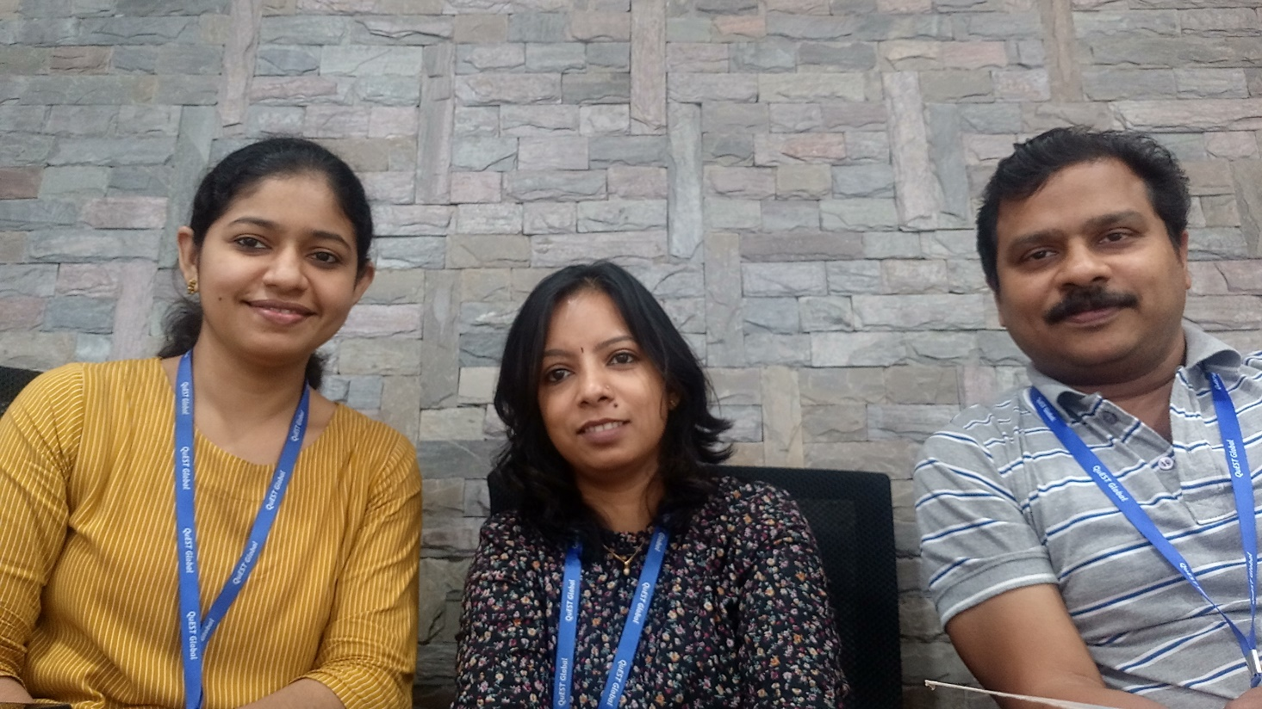
The Experience
The Team
Learned new technologies in a very short time
Notes:
THE EXPERIENCE: Add one liner by team member(s) as well as mentor about their overall hackathon experience. Teams may mention about learning something new, meeting new people, explain the process of building stuff, testing and validating their technical skills, etc. Mentor may talk about working with the team and their achievement at the hackathon.
PHOTO: Add picture of the team along with their developed prototype

Slide 10
Thank You

